Slide 1
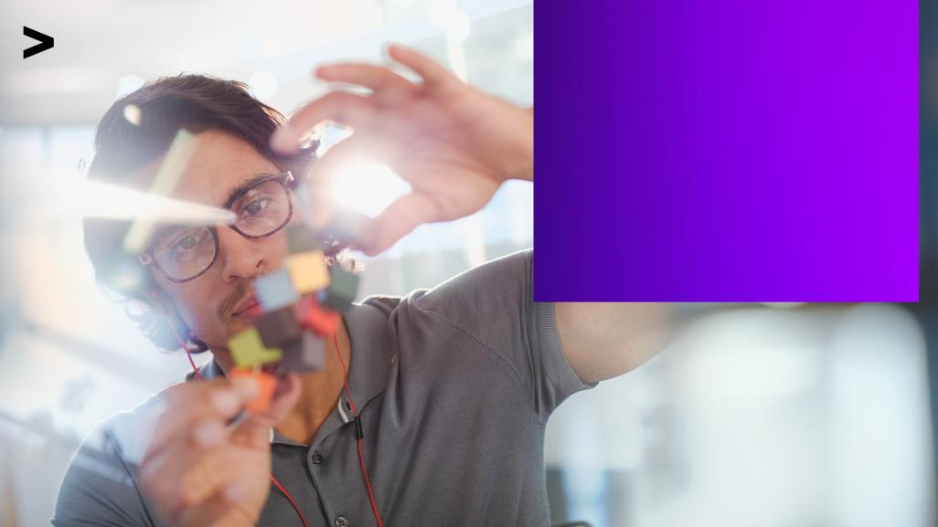
Accenture
Innovation Challenge
Innovate to create
360° value
Let there be change

Slide 2
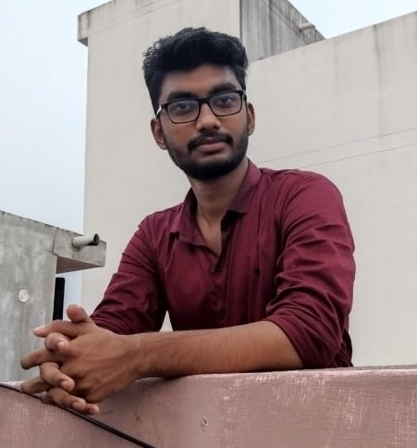
Team details
TEAM NAME: Ahmed
NUBAISH AHAMED S
College: Thanthai Periyar Government Institute of Technology, Bagayam, Vellore.
Stream: Electronic and Communication Engineering
Year of graduation: 2023

Slide 3

Theme
Please highlight one from the below:(Choose one and highlight it)
Innovate For Business
Develop innovative business solutions, offering or a business model that disrupts the competition in the given industry space
Innovate for Business
Innovate for Society
Innovate For Society
Apply technology in innovative ways to help improve the way we work and live, and create value for our society
Innovate for a Sustainable World
Innovate for a Sustainable World
Develop innovative business to tackle some of the world’s greatest ‘environmental challenges’

Slide 4
Describe the problem statement
As an Engineer I believe there is always an “update” for everything, then why not we update the mode of communication to the people who are far away from us (like Abroad). Before we used wait almost 15 days in order to share our words via letters, then we mobile phones to communicate at real time and finally we evolved sharing our live feeds and photographic communication. But the question is “Is it enough?” the answer would be NO. So many people are used to work or study far away from their parents, friends and families, they can interact with them using current technology but its not enough, we can do better we can make our communication far better from the communication and interaction we get now. As for me My Father works in abroad we use to talk and have video call’s every day but there is some thing that we cannot fulfil. There will always be some absence. To fill that gap there is a solution which can make those people get closer to their families and friends bit more. This can be implemented by using AR and VR (Augmented and Virtual reality) technology.

Slide 5
Proposed solution / your big Idea
SOLUTION : IMMERSIVE COMMUNICATION
My solution for the above stated problem is achieved by the technology virtual and augmented reality, which can also called Mixed reality. As an existence there are various use cases of AR VR and MR in gaming and various field. And they are used to escape the reality. Using this mixed reality concept by implementing it in wearables users can interact with the other on their desired location or place by creating the place virtually, it can be anywhere in and out of the world. Or they can share their own environment. And by using various sensors we can make them feel the presence of each others and to produce the touch feeling to our skin and also making the environment more realistic by concentration on Hand Tracking, Voice Enabled, Eye Tracking, Spatial Mapping, etc. and Fully articulated hand tracking, touch, grasp, and move holograms can also used in ways that to make feel natural. To increase the immersion of the environment and feed, we can use 3D,4D or even 5D technology. The main thing we miss in our interaction is feeling of their presence so by providing this feature in communication the above stated problem can be solved most.
TECHNOLOGY USED : Mixed Reality, Virtual reality, sensor, computer vision, graphical processing, display technologies and cloud computing.

Slide 6
How does your innovation create 360° value?
It changes everything around world. It create an great impact on every field such as society, business, how we live and how we interact. It might be the next level of communication. It would make tremendous growth in education because of the easy and efficient learning. Most of all it would make our lives easier. By using this we can work virtually and encounter various places that are both real and fantasy. It will lesser the distance between the people and connect them socially. We can always stay with our loved one’s.
“The best way to predict the future is to create it”

Slide 7
Thank you!

